Slide 1










Joyful Analytics present
The Happiness Project
Sunil Malhi
Tafadzwa Fararira
Yuk Hang Hui
Nida Ballinger-Chaudhary
Notes:
Sunil - Title/team name/group members
Good evening everyone. Today, I have the pleasure of introducing our team the Joyful Analytics and our final project: The Happiness Project – a project that sits at the intersection of data science and well-being.
As we navigate the complexities of modern life, the pursuit of happiness remains at the core of our endeavours. But happiness often feels like an enigma – a subjective experience influenced by myriad factors that vary from person to person. That's where our project steps in.

Slide 2
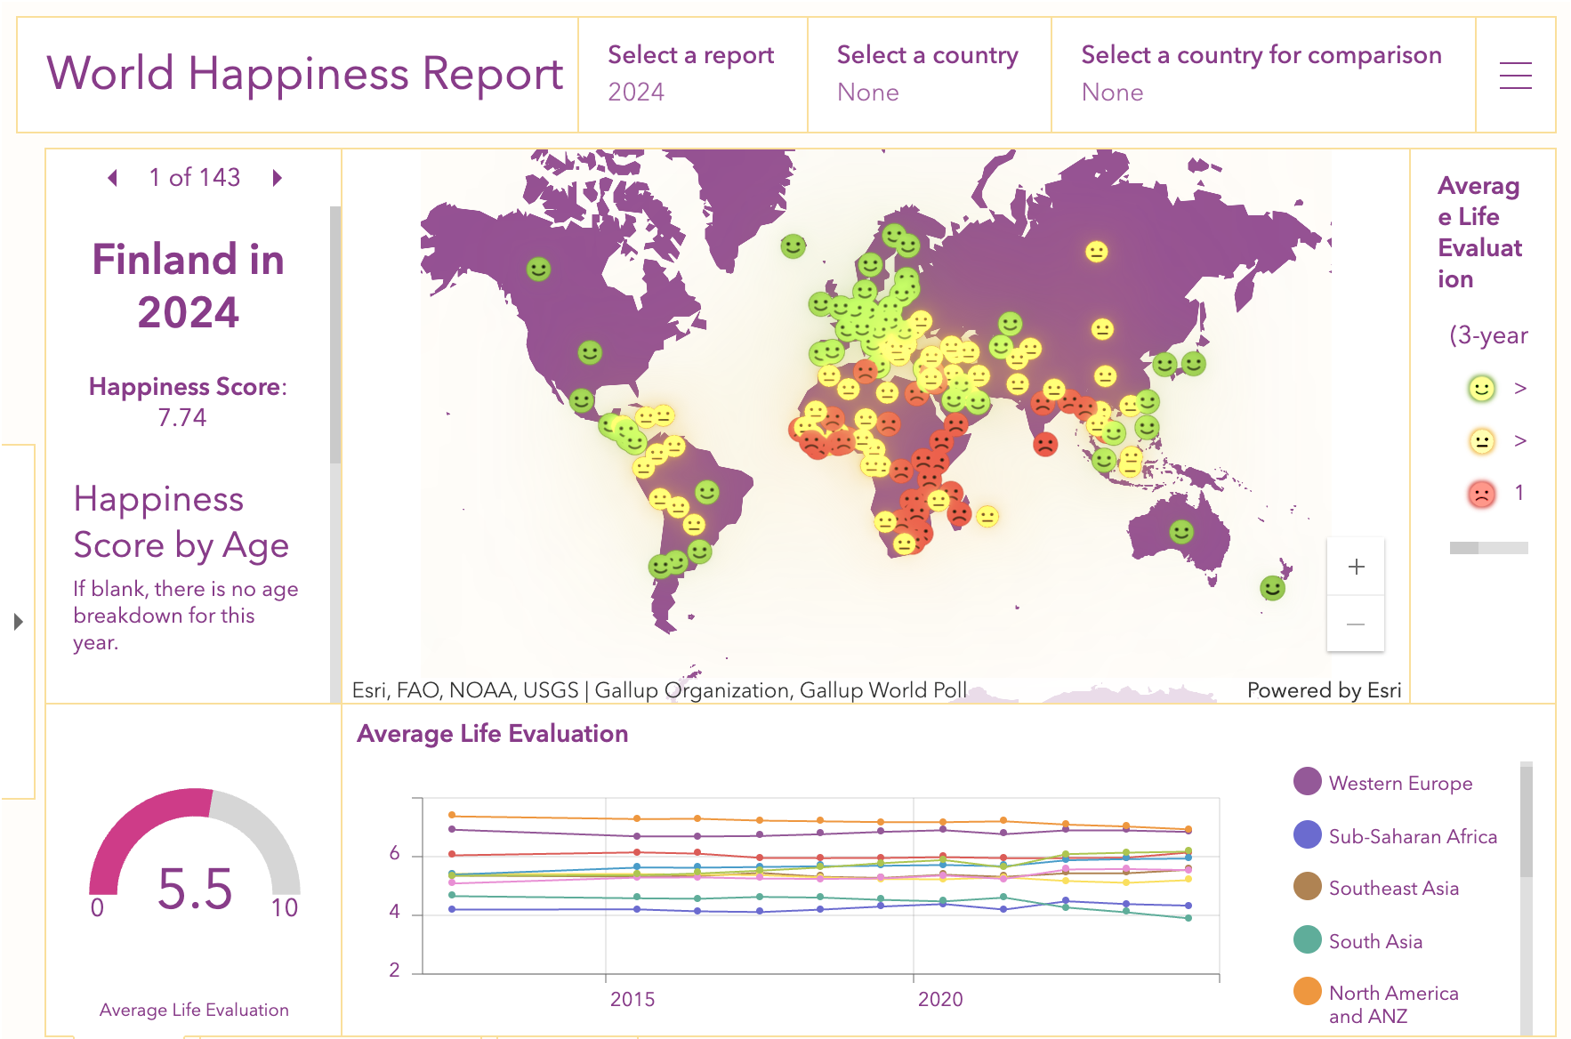
Unlocking Happiness
Understanding What Influences Our Well-being
Utilizing data to predict happiness levels
Insight into factors that contribute to well-being
Enhancing awareness and personal growth
Notes:
Sunil – Motivation
We've taken a data-driven approach to unravel the elements that play pivotal roles in shaping our sense of happiness. By analysing the World Happiness Report's extensive dataset, we aim to build a model that doesn't just predict overall happiness levels but also provides a deeper understanding of how different factors contribute to our well-being. From economic prosperity and social support to personal freedoms and health – our model considers it all.
While we have only been able to classify a dichotomy our ultimate goal is to be able to offer individuals personalized insights that can aid in self-awareness and personal growth. Imagine being able to pinpoint the areas of your life that, if improved, could significantly boost your happiness. That's the empowering potential of this project. But this is more than just an academic exercise. By shedding light on the quantitative aspects of happiness, we also hope to spark conversations and actions that lead to positive change at both individual and societal levels. So, let's dive in and explore the fascinating insights our data reveals because understanding happiness is the first step toward creating more of it.

Slide 3

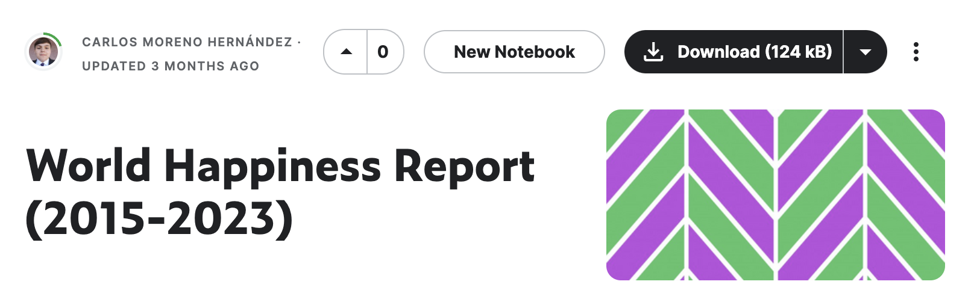
Exploring the Data Landscape
Dataset and Key Variables
GDP per Capita
Reflecting the economic health and individual prosperity.
Social Support
Measuring the presence of support networks.
Healthy Life Expectancy
Gauging the average health and wellness span.
Freedom to Make Life Choices
Assessing the personal autonomy in life decisions.
Generosity
Capturing the average propensity to help others.
Perceptions of Corruption
Understanding trust in institutions.
Dystopia Residual
Representing the unexplained contentment with life.
Social Support
Healthy Life Expectancy
Freedom to Make Life Choices
Generosity
Perceptions of Corruption
Dystopia Residual
Notes:
Sunil – Dataset and Variables
We used a dataset from Kaggle that had compiled the World Happiness Report, an annual publication of the United Nations Sustainable Development Solutions Network from its inception in 2015 to 2023. This dataset provides a comprehensive snapshot of the state of global happiness, compiled from responses of thousands of individuals across various countries.
The key variables we focus on include GDP per Capita, Social Support, Healthy Life Expectancy, Freedom to Make Life Choices, Generosity, Perceptions of Corruption and Dystopia Residual.
I now handover to Nida, to tell you about the ETL and EDA.

Slide 4
Notes:
Nida – ETL
Our team has meticulously cleaned and processed the data to ensure the highest level of accuracy and reliability for our model. We've removed any discrepancies and standardized the variables to create a robust foundation for our analysis.
The integrity of our dataset is paramount, as it directly influences the insights and predictions we generate. With a strong commitment to data quality, we stand confident in the findings that emerge from our model.

Slide 5
Notes:
Nida - EDA

Slide 6
Notes:
Nida – Model Development

Slide 7
Notes:
Yuk – Performance Comparison

Slide 8
Notes:
Yuk – Rationale behind choosing Random Forest Model

Slide 9
Notes:
Yuk – Showcase code to save as serialised object

Slide 10
Notes:
Taz – Showcase app.py code/deployment

Slide 11

Will our model classify you as ‘Happy’ or ‘Not Happy’?
Find Out For Yourself

